Slide 1
Computer Aided Design (CAD)
CAD refers to Computer Aided Design, it is the process of taking advantage of computers and graphics devices to help designers complete the design work.
In the process of design, there is a need to do a lot of computation, analysis and comparison on different schemes by computer, so as to determine the optimal solution.

Slide 2
CAD APPLICATION HELPS IN ASSISTING DESIGNER IN MAKING 3 DIMENSIONAL SKETCHES AND LANDSCAPE MODELS/DESIGNS USING COMPUTER GRAPHICS AND TOOLS
COMPUTERS
GRAPHIC
DEVICES
AUTOCAD
SKETCH UP
IN VERY QUICK TIME

Slide 3
Making of designs with AUTOCAD OR SKETCH UP applications, post processing of image or design is done using the different photoshop and tools to give viewer different impression

Slide 4
The various designed information in the form of numbers, text or graphics can be stored in computer memory and it can be quickly retrieved.
In CADS, designer firstly conceives the concept plan, draws the plan map by AutoCAD, including garden road networks, water shapes, terrain designs and plant configurations, and then completes modelling by Sketch Up, 3Dmax or other similar software, mainly including building models, water and terrain of height given, material of square pavement sketch given.

Slide 5
After rendering the map, designer makes post processing on the work by photo shop and then complete a garden landscape rendering.
Making use of landscape renderings of hand-painting or computer drawing, designer could build up an effective communication bridge to viewers in an intuitive way.
Compared with freehand drawing, rendering has high definition, high reduction degree, and not only is conducive to an intuitive understanding, but also can be treated as reference of conceived scheme.

Slide 6
Advantages
High efficiency
In this process, excellent drawing skills and techniques will play a key role.
The performance way of hand-painting will deliver unlimited reverie to people, but meanwhile its limitations also gradually come to the surface.

Slide 7
By adopting computer graphics, this problem can be easily solved, for example, to accurately calculate the proportional relationship between each garden ornament, building and plant.
In hand-painting process, each drawing cannot be occupied by multi-designer at the same time, and the drawing skill and style of all the designers is hard to strictly universalize; but CAD technology can greatly improve the work efficiency, and ensure unified design style.

Slide 8
Rich expression way
Computer graphics can show rich reality sense, three-dimensional shadow and multi-sensory experience of virtual reality, to simulate mountain stream, seasonal changes and walking effect, which is much different from traditional hand-painting way.
Thanks to bold innovation of designers, hand-painting and computer graphics are combined more and more closely nowadays.
With the HD scanning technology, papery hand-drawn map can be transferred into computer, and then imitate the color and style of to draw it, forming a unique way of expression.

Slide 9
Less resource consumption
Traditional modeling performance was in the form of sculpture, which need the coordination of certain material to complete one garden landscape design works.
In addition, from purchase to producing, it always needs related technical personnel to collaborate; while CAD technology modeling process only needs one personnel from beginning to end.
Its biggest advantage lies in its fast modeling speed and high replicability, so that it can get rid of time and space limitation, to allow the modeling be discolored and reshaped.
Therefore, using CAD technology in garden landscape design would greatly save the resource consumption

Slide 10
Disadvantages
Garden landscape design is an art of time and space.
Characters of Chinese garden, especially natural style garden has formed complex terrain and utilize the solitary plant, group plant and mass plant to create abundant space with vividness.
In CAD garden design works, because the pattern scale and line thickness is too normative, and often need to use the command, the lack of vividness leads to the lack of interesting in garden landscape design.
Garden landscape design mainly focuses on plant landscape, so the vividness is quite important.

Slide 11
Three-dimensional space shortage
In the domestic, garden designers often complete landscape graphic design, and then import it into 3Dmax for modeling and rendering, and finally complete post-processing with Photoshop.
This has already become a standard mode. However, such production mode is not only a waste of time, but also a waste of human and material resources.
Although its effect is real enough, the scene is very different because of the weak relevance between two-dimensional and three-dimensional scene.
In garden landscape design, CAD technology lacks the technical parameters of the three-dimensional and the functions of integrating solid modelling with rendering and animation.

Slide 12
Procedure of Landscape Design with CAD Technology
A. Modeling
In general, the widely used modelling software includes AutoCAD and MAYA series software. AutoCAD is accurate mapping software, which can be used to draw project plan, and then switch into MAYA by data exchange as two-dimensional plan for modelling of three-dimensional positioning template.
In data exchange, if want to import into MAYA in 3DS format, you need to install 3DS Input plug in firstly, and load and active it in 3DS plug-in manager.

Slide 13
It can be achieved in three ways as follow:
In view of encourage modelling, designer can make a simple shape modeling and process it by mapping techniques.
In this way, it can achieve the effect of post-treatment.
Rapid development of computer of MAYA Paint Effect, after creating project-related plant brushes in advanced, designer can quickly append plant entourage in 3D scan
Use the software Xfrong, which is specialized in the production of organic structure, to apply its special mapping and distribution skill to design huge garden ecosystem, and then import it into MAYA for integration and rendering.

Slide 14
Rendering
The rendering process is to use renderer integrated in MAYA to complete it.
The textures and lighting tools in MAYA have provided strong functions of lighting control and texture creating and editing.
It can not only build various authentic textures, but also create illusory textures that do not exist in real world.
By careful creation, designer can authentically reproduce various Texture and characteristics in design drawings.
The key technology to accurately create texture is to accurately align the model with bitmap and its modifier, and pay attention to dimension of each texture.
When the lighting and texture of model are set correctly, it can be rendered with computer. What is the difference, map sheet of hand renderings should be determined at the very beginning, while that of computer renderings just need to be determined before rendering.

Slide 15
Post-processing
Post-processing is similar to the final adjusting and polishing process of hand renderings. It is to conduct polishing and machining of the obtained image file in the rendering stage.
For garden landscape renderings, adding of entourage and background is an important step. The software used in this step is Photoshop, which is one of the most outstanding graphic image processing software nowadays.
Perspective effect of entourage (especially plants) is to refer to perspective angle of the image obtained by rendering and its perspective law to adjust the entourage in terms of size, orientation and color.
As the same as other type of renderings, entourage files of garden landscape renderings obtained mainly in three ways

Slide 16
Map depot file: there are many software products containing various entourage in the market;
Scan various exquisite pictures of entourage from books, and then process them with Photoshop;
Directly take the photos from real life by digital camera.

Slide 17
CAD Application
Examples-AutoCAD

Slide 18
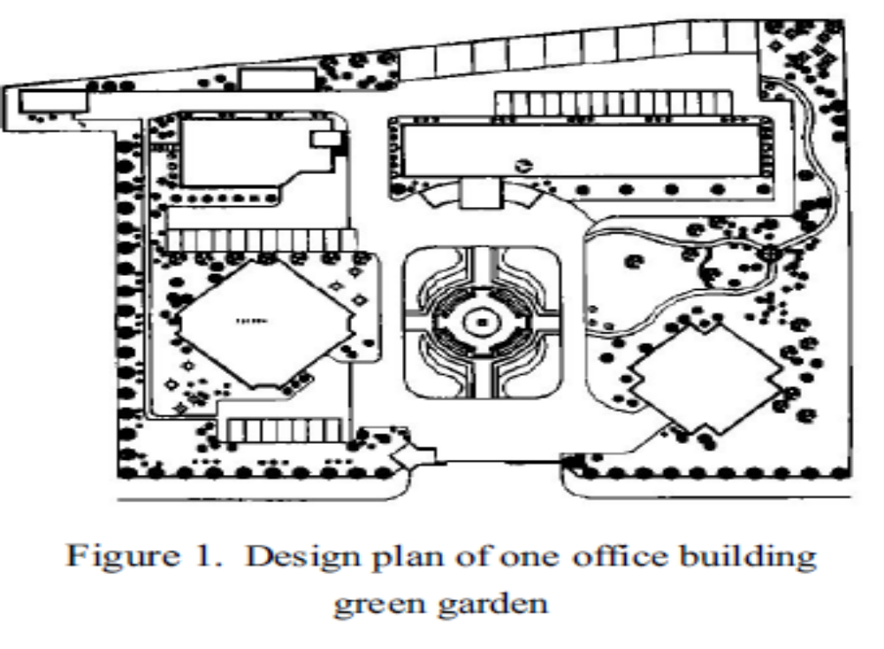

Slide 19
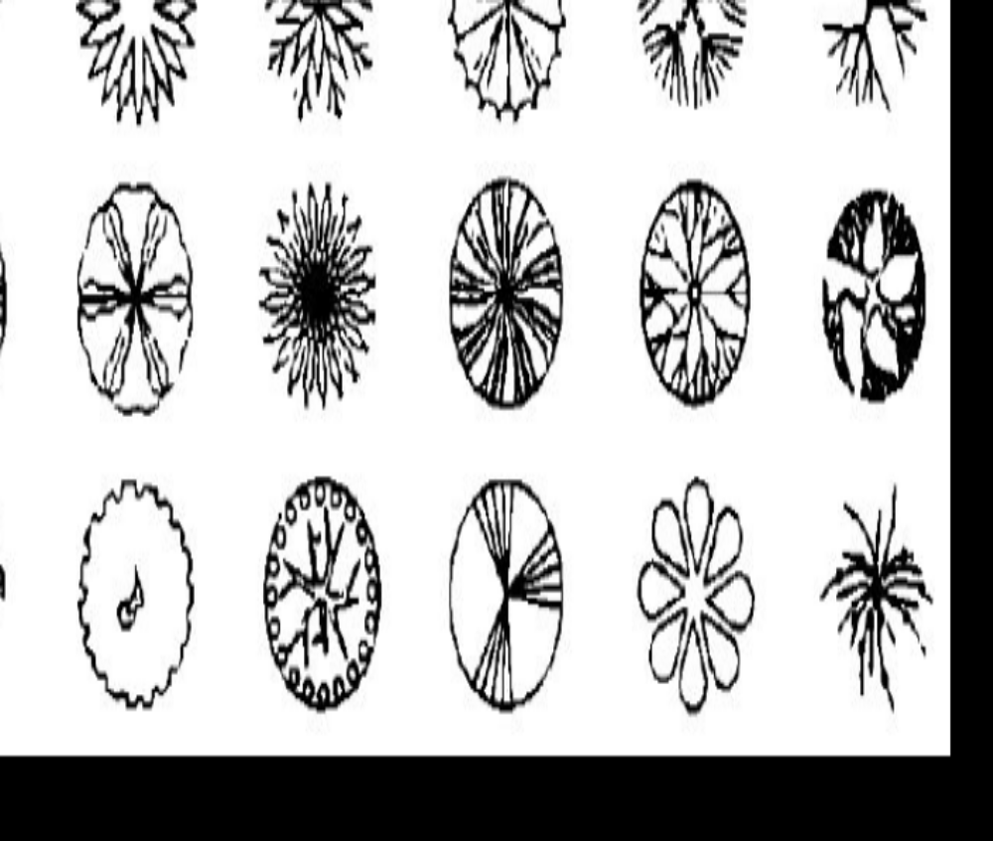
Designing the Landscape through CAD Application

Slide 20
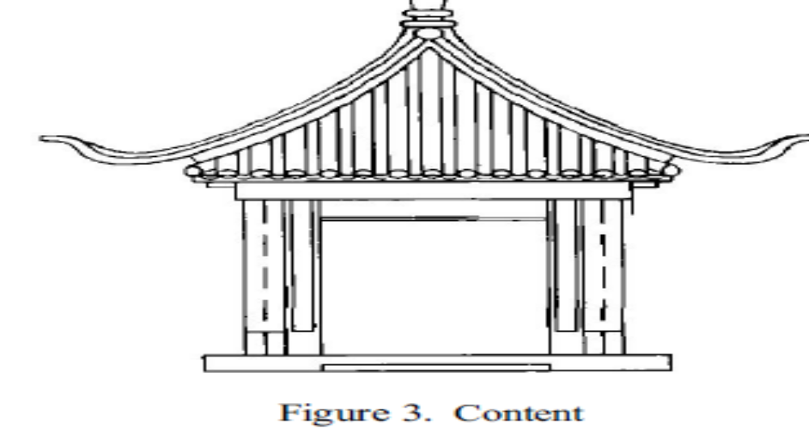
In addition, some command such as COPY, OFFSET etc. can be widely used

