Slide 1
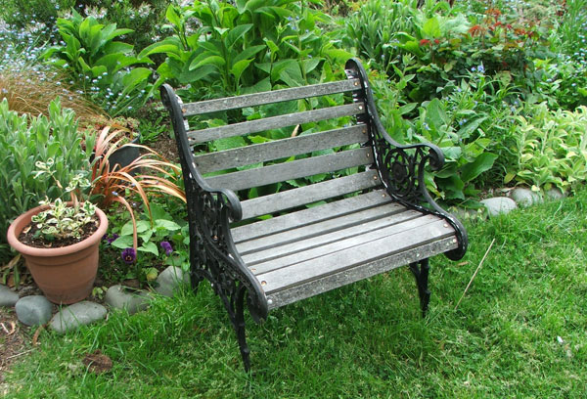
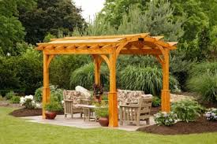
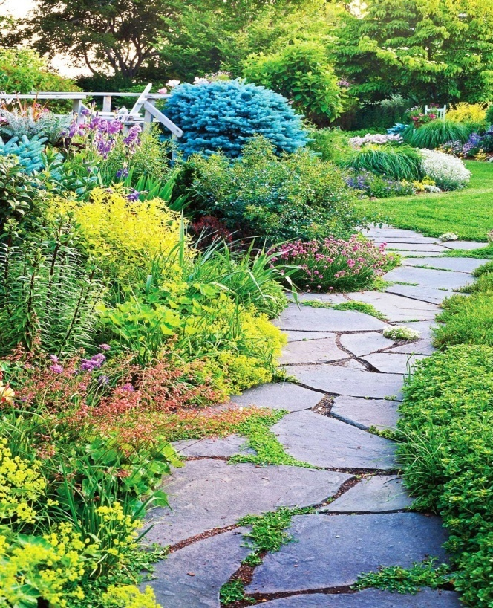
Garden Adornments

Slide 2
Garden adornments
Several accessories such as bird bath, sun clock, fountains, garden seats, ornamental posts, pillars, etc., which make the garden more enjoyable are referred to as Garden Adornments
They harmonise together to give garden overall natural and beautistic effect.
These elements make garden more adorable

Slide 3
Garden-seats
The garden-seats should not look out of place. They should be comfortable, durable and artistic looking.
Seats made out of wooden or fabric material are comfortable to sit compared to those built in stone or iron.
The wood used is to be treated with a preservative and painted with moisture proof chemicals.
Iron or stone or concrete seats get easily heated in the summer months and become cool in the winter months, thus making them uncomfortable to sit.
Concrete or stone seats are preferable in public parks as they are durable in nature.

Slide 4
Garden-seats

Slide 5
Ornamental tubs, urns and vases
The tub or the vase can be made of timber or preferably of brick, concrete or carved out of stone, which can be kept permanently or temporarily.
These can be positioned over ornamental pillars, at the end of paved paths, near the gate or near the staircase of the main entrance.
Ornamental urns made of metal with carvings outside look beautiful in the terrace, near the staircase or even inside the house.

Slide 6
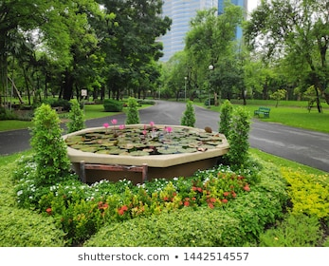
GARDEN VASES
ORNAMENTAL TUBS/URNS

Slide 7
Bird bath
It is a large, bowl-shaped container generally made of concrete, fixed over a pillar or column, which is about 1m tall.
Water is stored in the bowl for the birds to come and drink or bath in it.
Bird baths may be constructed at the quiet corner of the garden.

Slide 8
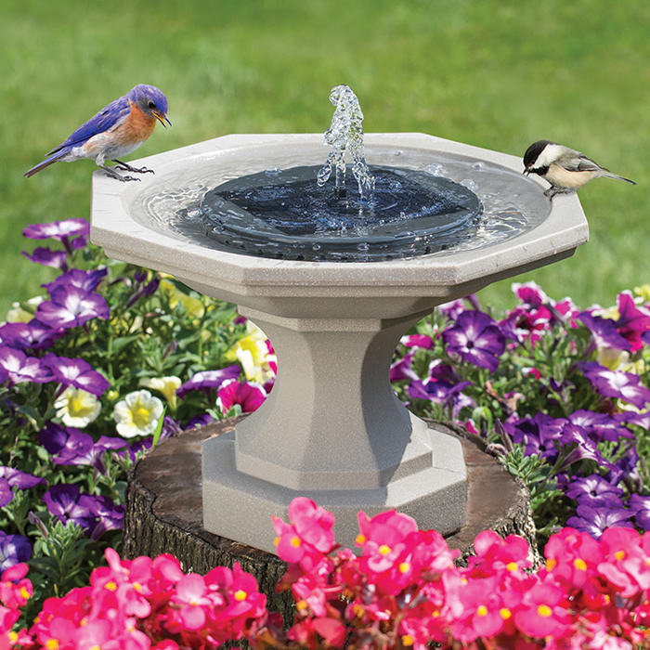
Bird Baths

Slide 9
Floral clocks
These are huge clocks generally operated by electricity, having huge hands for showing the seconds, minutes and hours.
The machinery of the clock is concealed in an underground chamber with only the hands showing above the ground against a dial of carpet bedding plants or flowerbeds.
Instead of live plants, the dial can be decorated with various coloured pebbles.

Slide 10
Floral clocks

Slide 11
Foot paths
Foot paths facilitate movement within the garden area.
Foot paths may be winding, circular or straight. Spinal or herring-borne designs can also be adopted.
Winding foot path conceals the components beyond and creates curiosity. Straight foot paths make one walk fast.
A vista at the end of a straight foot path adds beauty to the scenery

Slide 12
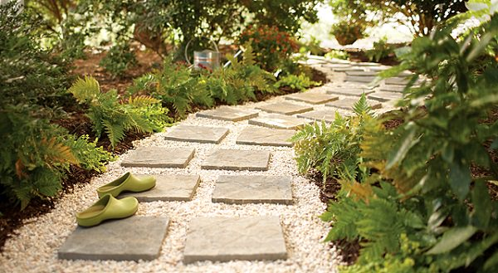
Garden walk paths or foot path

Slide 13
Garden Trellis
A garden trellis makes the most of limited space with a vertical display of lush greenery and colourful blooms.
Creates a privacy screen in a garden or balcony
Provides support for large vines and trailing plants
Screens an unattractive area of the landscape
Provides shelter from wind
Provides shade for sitting area
Climbers such as climbing roses, Clematis, English ivy, passion flower, etc. are suitable for trellises

Slide 14
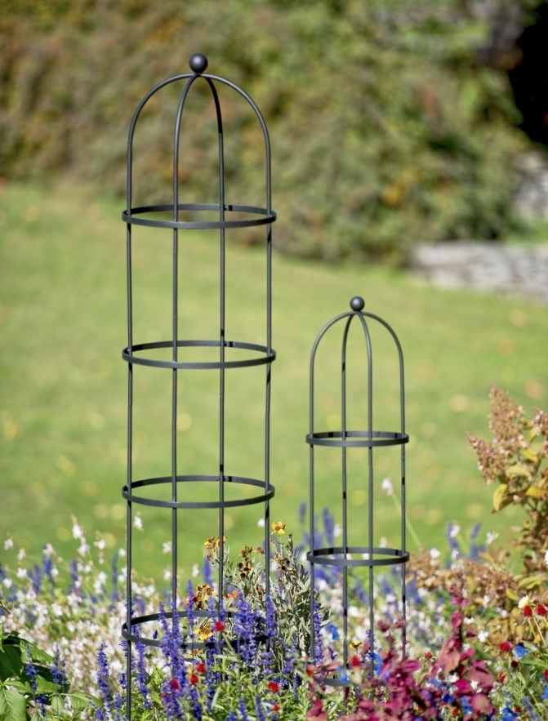
Garden Trellis

Slide 15
Pergola
A pergola is formed by connecting a series of arches over a considerable length. Usually flowering creepers are trained over the arches.
A pergola is a useful resting place during the summer months in tropical regions.
The path below remains cool due to the creepers growing above. Below the pergola, concrete or wooden benches may be constructed for sitting.

Slide 16
Pergola

Slide 17
Arches
Arches are supports provided for climbers. It should be at least two meter height and one metre wide.
The breadth depends upon the path over which it is constructed but should not be less than 1 metre.
Arches may be made of wood, metal, stones or concrete structures.

Slide 18
Arches

