Slide 1
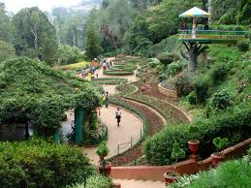
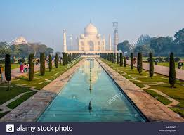
Different Styles of Gardens
Description of Formal , Informal and free style gardening

Slide 2
Formal Garden
This type of garden is laid out in a symmetrical pattern. Everything in this type of garden is laid in straight lines. These types of gardens are either square or rectangular in shape.
If you divide the garden by drawing a straight line, one part is the mirror image of the other i.e. the planting on one side is the replica of the other side.
The flower beds are also of geometric shapes. The arrangements of trees and shrubs are always geometrical and are kept in shape by trimmining and training.

Slide 4
General features
Gardens are formal in style; symmetrically planned with rectangular or square plots.
All Moghul gardens were extended Char bagh design of paradise garden of Persia.
The garden area is divided into four plots by water channels. These four channels represent four rivers of life. The running water provides coolness and freshness to the garden. Reflection of sky and trees provide unique beauty to the eye.
The four plots are planted with trees, shrubs, etc.
The axis is straight and central and sometimes represented by tree lines.
The water pool created in the centre with over flowing water serves as central specimen.
Fountains, cascades are linked to central pool to create scenic beauty.In latter phase terminal building (Taj Mahal) has been added to enhance vista.

Slide 5
Terrace
Terraces are components to maintain the proportion of land for extended view irrespective of topography of the area 7, 8 or 12 terraces symbolize 7 planets, 8 paradise and 12 zodiacal signs. The entrance is located at the lowest terrace. As the Moghul emperors came from a hilly country, the idea of building a garden in terraces came to them naturally.

Slide 6
Running water
Water is the life and soul of Moghul garden. Love for running water made the Moghuls to select sites centering round hill sides and rivulets for their garden.
The idea of constructing canals and tanks to keep the water brimming to the level of paths on either side was borrowed from Persians.
Water channels were paved with tiles of brilliant blue color to reflect the sky and give impression of depth.
Various patterns were used for paving the marble stones and style so that running water is thrown up and broken into ripples such white shawls of water is characteristic

Slide 7
Site and Design
A perennial river, the slope of a hill and river banks were the places selected for this purpose. A typical Moghul garden is square or rectangle in shape. It is not merely a garden but serves the purpose of fort, residence and a place for recreation.

Slide 8
High protecting wall
Moghul gardens are protected by a high strong wall.
The top of the wall is adorned with serrated battlements.
The presence of high wall was protection against enemy and hot winds of summer.

Slide 9
Entrance
Entrance is generally tall and gorgeous. Doors are huge and strong wooden structure studded with heavy iron nails and spikes.
Heavy gates are provided to protect the kings & gardens from enemy attack.

Slide 10
Baradari
It is a canopied building with twelve open doors ie., three in each direction.
From baradari, one can sit and enjoy the fresh breeze and watch dark clouds and birds in the sky.
The masonry pillars of baradari were painted with favourite design of bouquets of flowers in vases and the floor was furnished with thick carpets and cushions.

Slide 11
Flower beds
The flowers in Moghul gardens are mostly scented in nature and highly colourful.
The colourful effects were created by massing mixed coloured annuals mixed colours have been preferred rather than mono, complementary or contrast colours.

Slide 12
Symbolism in formal gardens
Water: Source of life
Cross at intersection of water channel meeting humanity with God.
Eight divisions: Eight divisions of Koran
Alternate planting of cypress and flowering trees: Immortality and renewal of life.
Bauhinia alba: Youth and life.

Slide 13
Formal gardens
Taj Mahal , AGRA

Slide 14
Rashtrapati Bhawan

Slide 15
Informal Style of Gardening
In this style, the object is to plant trees in a natural way without following any hard and fast rules.
Roads and paths are not straight but are curved. Irregular shape is given to water bodies.
Flower beds are made of irregular shape to conform with the surroundings.
Plants are grown in natural form.
Japanese gardens are of this style. They are often called as "Nature in Miniature"

Slide 16
Features of Informal gardens
They are nature recreated in miniature.
They aid a person to meditate peacefully.
The colourful leaves or flowers which distract the eyes are avoided.
The green foliage plants are made use of
Totally informal in design.
The natural elements like, mountains, islands, rivers, lakes, streams, bridges are made use of as components.

Slide 17
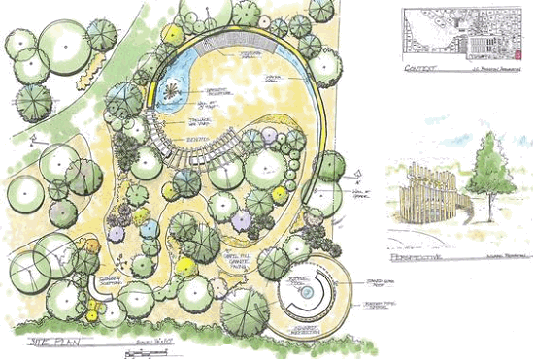

Slide 18
Main features of garden are hills, streams and ponds along with other features
1)Ornamental water Water is the life of the garden and necessary feature of Japanese hill gardens. It may be present in the form of big lakes with a calm tranquil surface or symbolically in the form of water basins of natural shape. Waterfall is another means to bring the natural setting into a garden. A group of stones is raised and water is allowed to fall from it naturally. The trees are planted in front of the place where waterfalls. Wells serve a dual purpose for beauty as well as utility 1)

Slide 19
2) Islands
Islands are important feature and are located in the middle of the pond.
Rocks are used for foundation of island and soil is deposited on it.
Then trees are planted and stones are erected in an irregular manner to give natural touch.
Islands many be connected by a bridge or left isolated.
Different islands are formed because hills, lakes and islands are complementary beauties.
They are given personal touch by naming them as master island, guest island and central island.

Slide 20
3) Hills and hillocks
A bigger sized broad viewed hill forms the main feature (hill 1).
Secondary to it, a lower hill is created adjacent to hill 1 and is called companion hill (hill 2).
A lower hill 3 is projected front opposite to hill 1.
Hill 4 is elegantly introduced in the foreground close to hill 3 and below hill 2.
At the far end, hill 5 is to be located which could be seen from all parts of the garden.

Slide 21
4) Stones
The stone structures are used to depict different natural moods, ideas of spiritual and melodic. There are 5 such types of stones as described below
Status stone: A tall vertical stone bulging out towards middle and finishing at the top suggesting a human at thinking or meditating.
Low vertical stone: is rounded at the base and its top is bent resembling the bud of magnolia.
Flat stone: is a low broad stone of irregular shape with a flat top suggesting submissiveness.
Recumbent or ox stone: resembles trunk of an animal. Its long curved and bent boulder suggests an animal hiding in a bush.

Slide 22
Arching stone: is arch like as its name indicates and suggests flexibility in thought.
The above stones can be grouped into two, three or four to give different meanings as below: a) Three stones placed at the edge = long life stone of beach b) Two stones o the bank of lake = Good luck stone or river Such stones are located in ten positions in a hill garden most central (Guardian stone), opposite to the fall (companion stone), foreground centre (worshipping stone), foreground left (interviewing stone), foreground right (waiting stone), between two hills (man shadow stone), near central group of trees (cave stone), at the heart of the garden (seat of honour stone), 1st stepping stone (pedestal stone) and pair of stones near entrance (idling stones).

Slide 23
5) Trees
Principal tree: Group of trees planted at the central part of background.
View perfecting tree: A tree planted in the foreground of an island.
Tree of solitude: Group of trees with thick foliage in the background on one side.
Cascade screening tree: Group of bushy or leafy tree planted at the side of waterfall to hide the portion of it.
Tree of setting sun: is planted in the west side to filter the glare of setting sun.
Distancing tree: Pine plants planted to give a forest look.

Slide 24
6)Garden Pargoda
Stone and bronze lanterns were used to decorate Buddhist temples.
They became the thing of beauty in gardens also.
Standard lanterns or legged lanterns or stone lanterns are used in an informal manner to decorate the garden
7) Garden pagoda
It may be in the form of stone tower or pagoda.
The roof may have three, five or seven a nine or eleven separate roots.

Slide 25
8) Garden bridges
There are made of natural wood of stone varying in size and width.
They are used to connect islands. Either single stone or many pieces have been used to make the bridges sometime, semicircular arch.
Form of bridges is constructed on the special ponds to permit the passage of boats under it.
The bridges are named as wooden trestle bridge, ‘peeping’ bridge, ‘granite slat bridge’ curved bracket bridge, Chinese full moon bridge, etc.

Slide 26
INFORMAL GARDENS
Ooty Garden

Slide 27
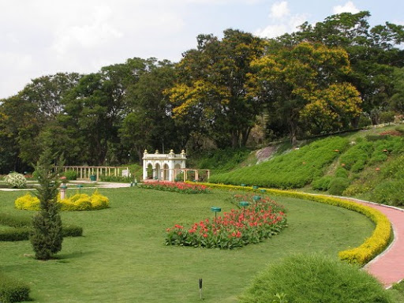
Rose Garden , Chandigarh

Slide 28
Free style Gardens
It is combination of both Formal and informal style of Gardens.
Kew Garden

